Slide 1
Masters thesis topic
15/03/2022

Slide 2
Structure
Introduction
The problem
Identify the cause
Collinearity
Classification

Slide 3
Introduction
Overview
Blanket
$$S_{α}+S_{h}=S_{B}+S_{κ}$$
$$S_{κ}=\frac{1}{V}∫_{A}q.dA=-2\frac{κ}{r}\frac{∂T}{∂r}$$
$$\frac{1}{V}∫_{A}q⋅dA=\frac{3}{2}\frac{p}{τ_{E}}$$
n
Steam
α
Steam
Core
Plasma
Heating
First
Wall
Ext.
power
γ

Slide 4
The problem
Energy confinement time
$$τ_{E,th}=α_{0}I_{p}^{α_{I}}B_{t}^{α_{B}}{\overline{n}}_{e}^{α_{n}}P_{ℓ,th}^{α_{P}}R_{geo}^{α_{R}}κ_{a}^{α_{κ}}ϵ^{α_{ϵ}}M_{eff}^{α_{M}}$$
Progression of regression coefficients
Database | α0 | αI | αB | αP | αn | αM | αR | αe | αk | no_of_points | ITER_tau
DB2P8 scrubbed | 0.0913 | 0.776 | 0.323 | -0.666 | 0.437 | 0.189 | 2.22 | 0.578 | 0.4 | 1310 | 7.88
DB2P8 scrubbed ITER | 0.136 | 0.963 | 0.147 | -0.664 | 0.334 | 0.3 | 1.84 | 0.372 | 0.6 | 732 | 8.98
STDDB4V5 scrubbed | 0.115 | 0.794 | 0.251 | -0.616 | 0.389 | 0.0646 | 1.97 | 0.712 | 0.471 | 3237 | 5.22
STDDB4V5 scrubbed ITER | 0.157 | 1.06 | -0.0129 | -0.615 | 0.322 | 0.155 | 1.59 | 0.378 | 0.725 | 2275 | 7.43
SELDB5 scrubbed | 0.128 | 1.13 | 0.0724 | -0.683 | 0.175 | 0.214 | 1.45 | 0.0636 | 0.28 | 6250 | 4.09
SELDB5 scrubbed ITER | 0.147 | 1.38 | -0.182 | -0.669 | 0.112 | 0.303 | 1.07 | -0.136 | 0.712 | 5220 | 4.73

Slide 5
Identify the cause
A
B
B
Φ
A$∩$B
B/A
Β/Α
A$∩$B
=
+
αR = 1.07
αR = 1.99

Slide 6
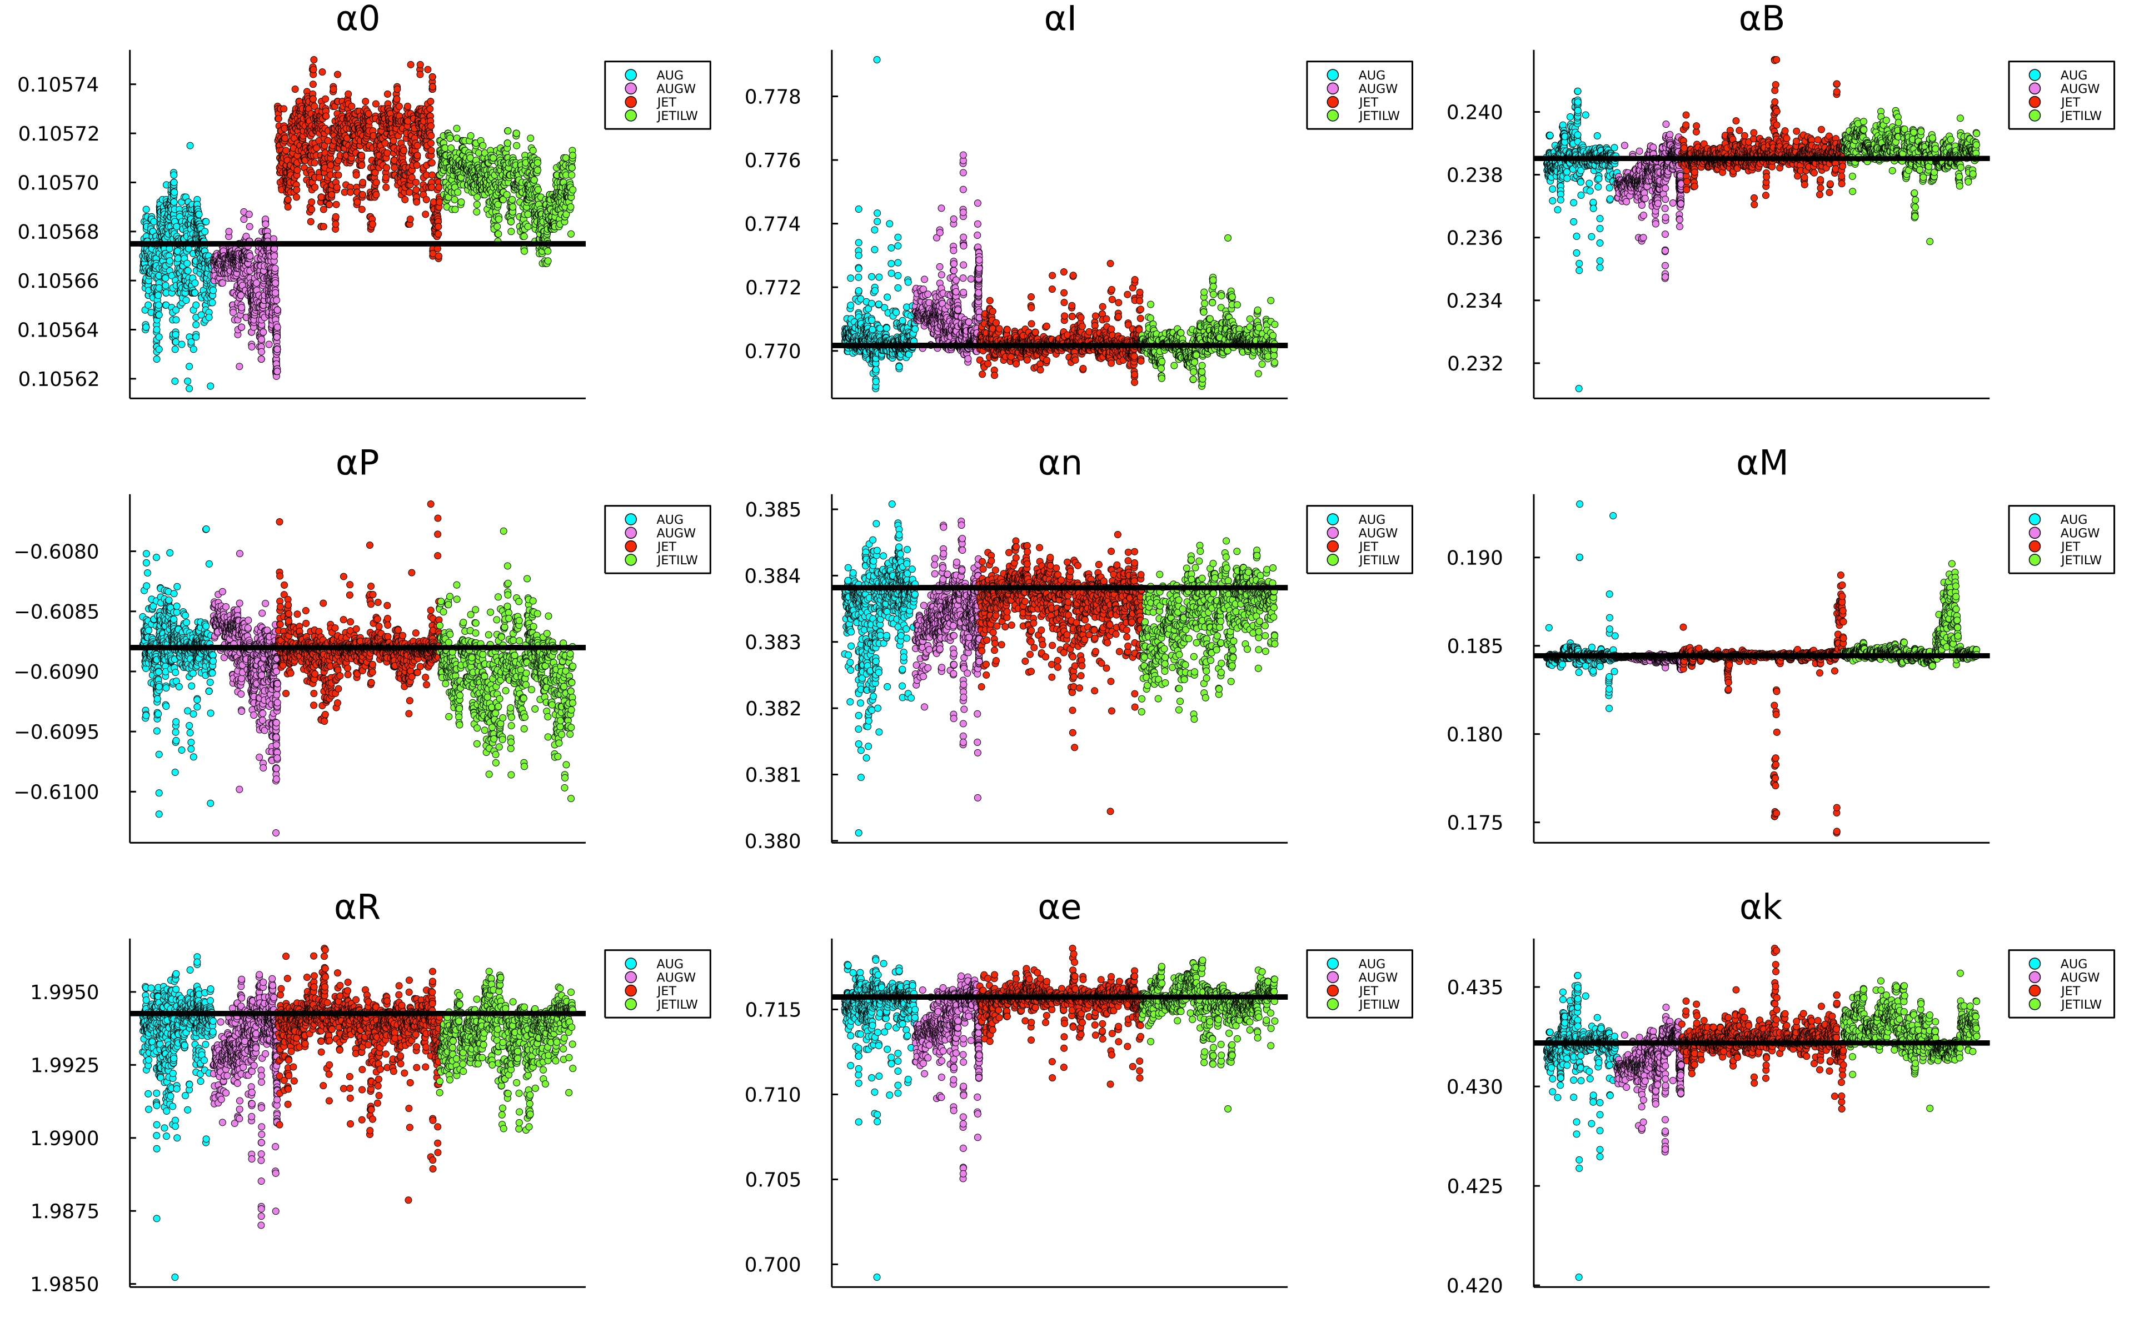

Slide 7
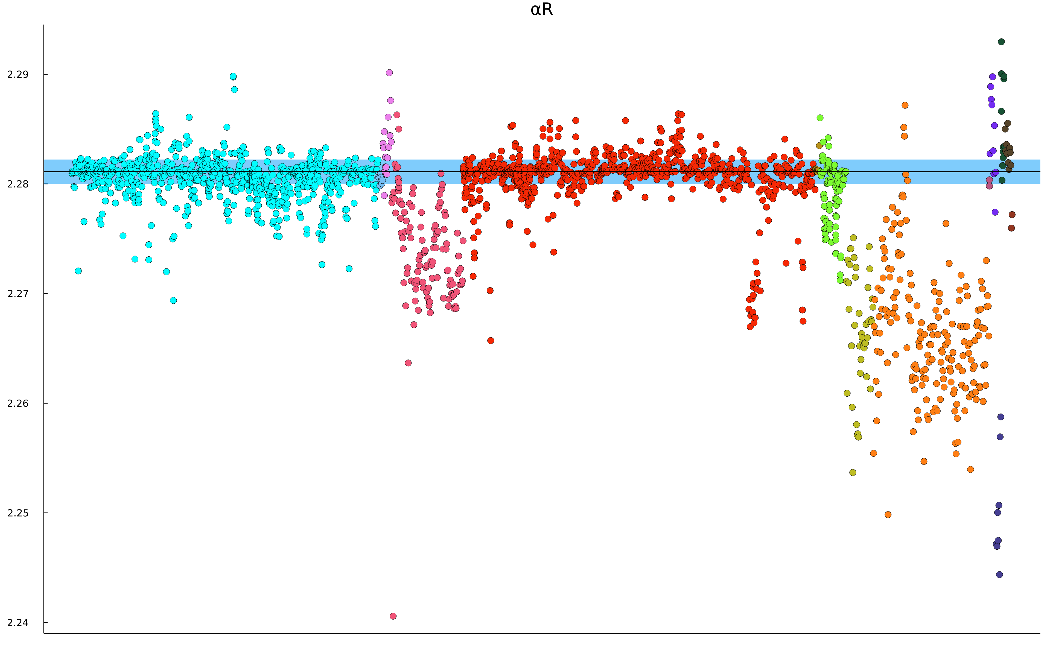
Optimisation problem
No deviation set
Deviation set
$$ℓ_{1}$$
$$ℓ_{2}$$
+
A$∩$B
+
A$∩$B
αR${}_{no_dev}$
αR${}_{dev}$
Objectives
Minimize $ℓ_{2}$
Maximize $|{α_{R}}_{no_dev}-{α_{R}}_{dev}|$ s.t ${α_{R}}_{dev}<{α_{R}}_{no_dev}$

Slide 8

Multi-collinearity
z | αx | αy
-10.0 | -0.59 | 0.099
-6.0 | -0.47 | 0.32
-2.0 | -0.34 | 0.5
2.0 | -0.21 | 0.7
6.0 | -0.084 | 0.9
10.0 | 0.026 | 1.1
Uncorrelated clusters
N (dimensionality of predictor space) clusters provide sufficient data to determine a pseudo stable regression hyperplane
Correlated variables
z | αx | αy
-9.0 | -0.36 | 0.32
-1.0 | -0.2 | 0.63
0.0 | -0.18 | 0.68
3.0 | -0.12 | 0.79
5.0 | -0.083 | 0.86
10.0 | 0.012 | 1.1
$$y=2x$$
It is clear that the smallest deviations in data cause wild fluctuations in coefficients

Slide 9
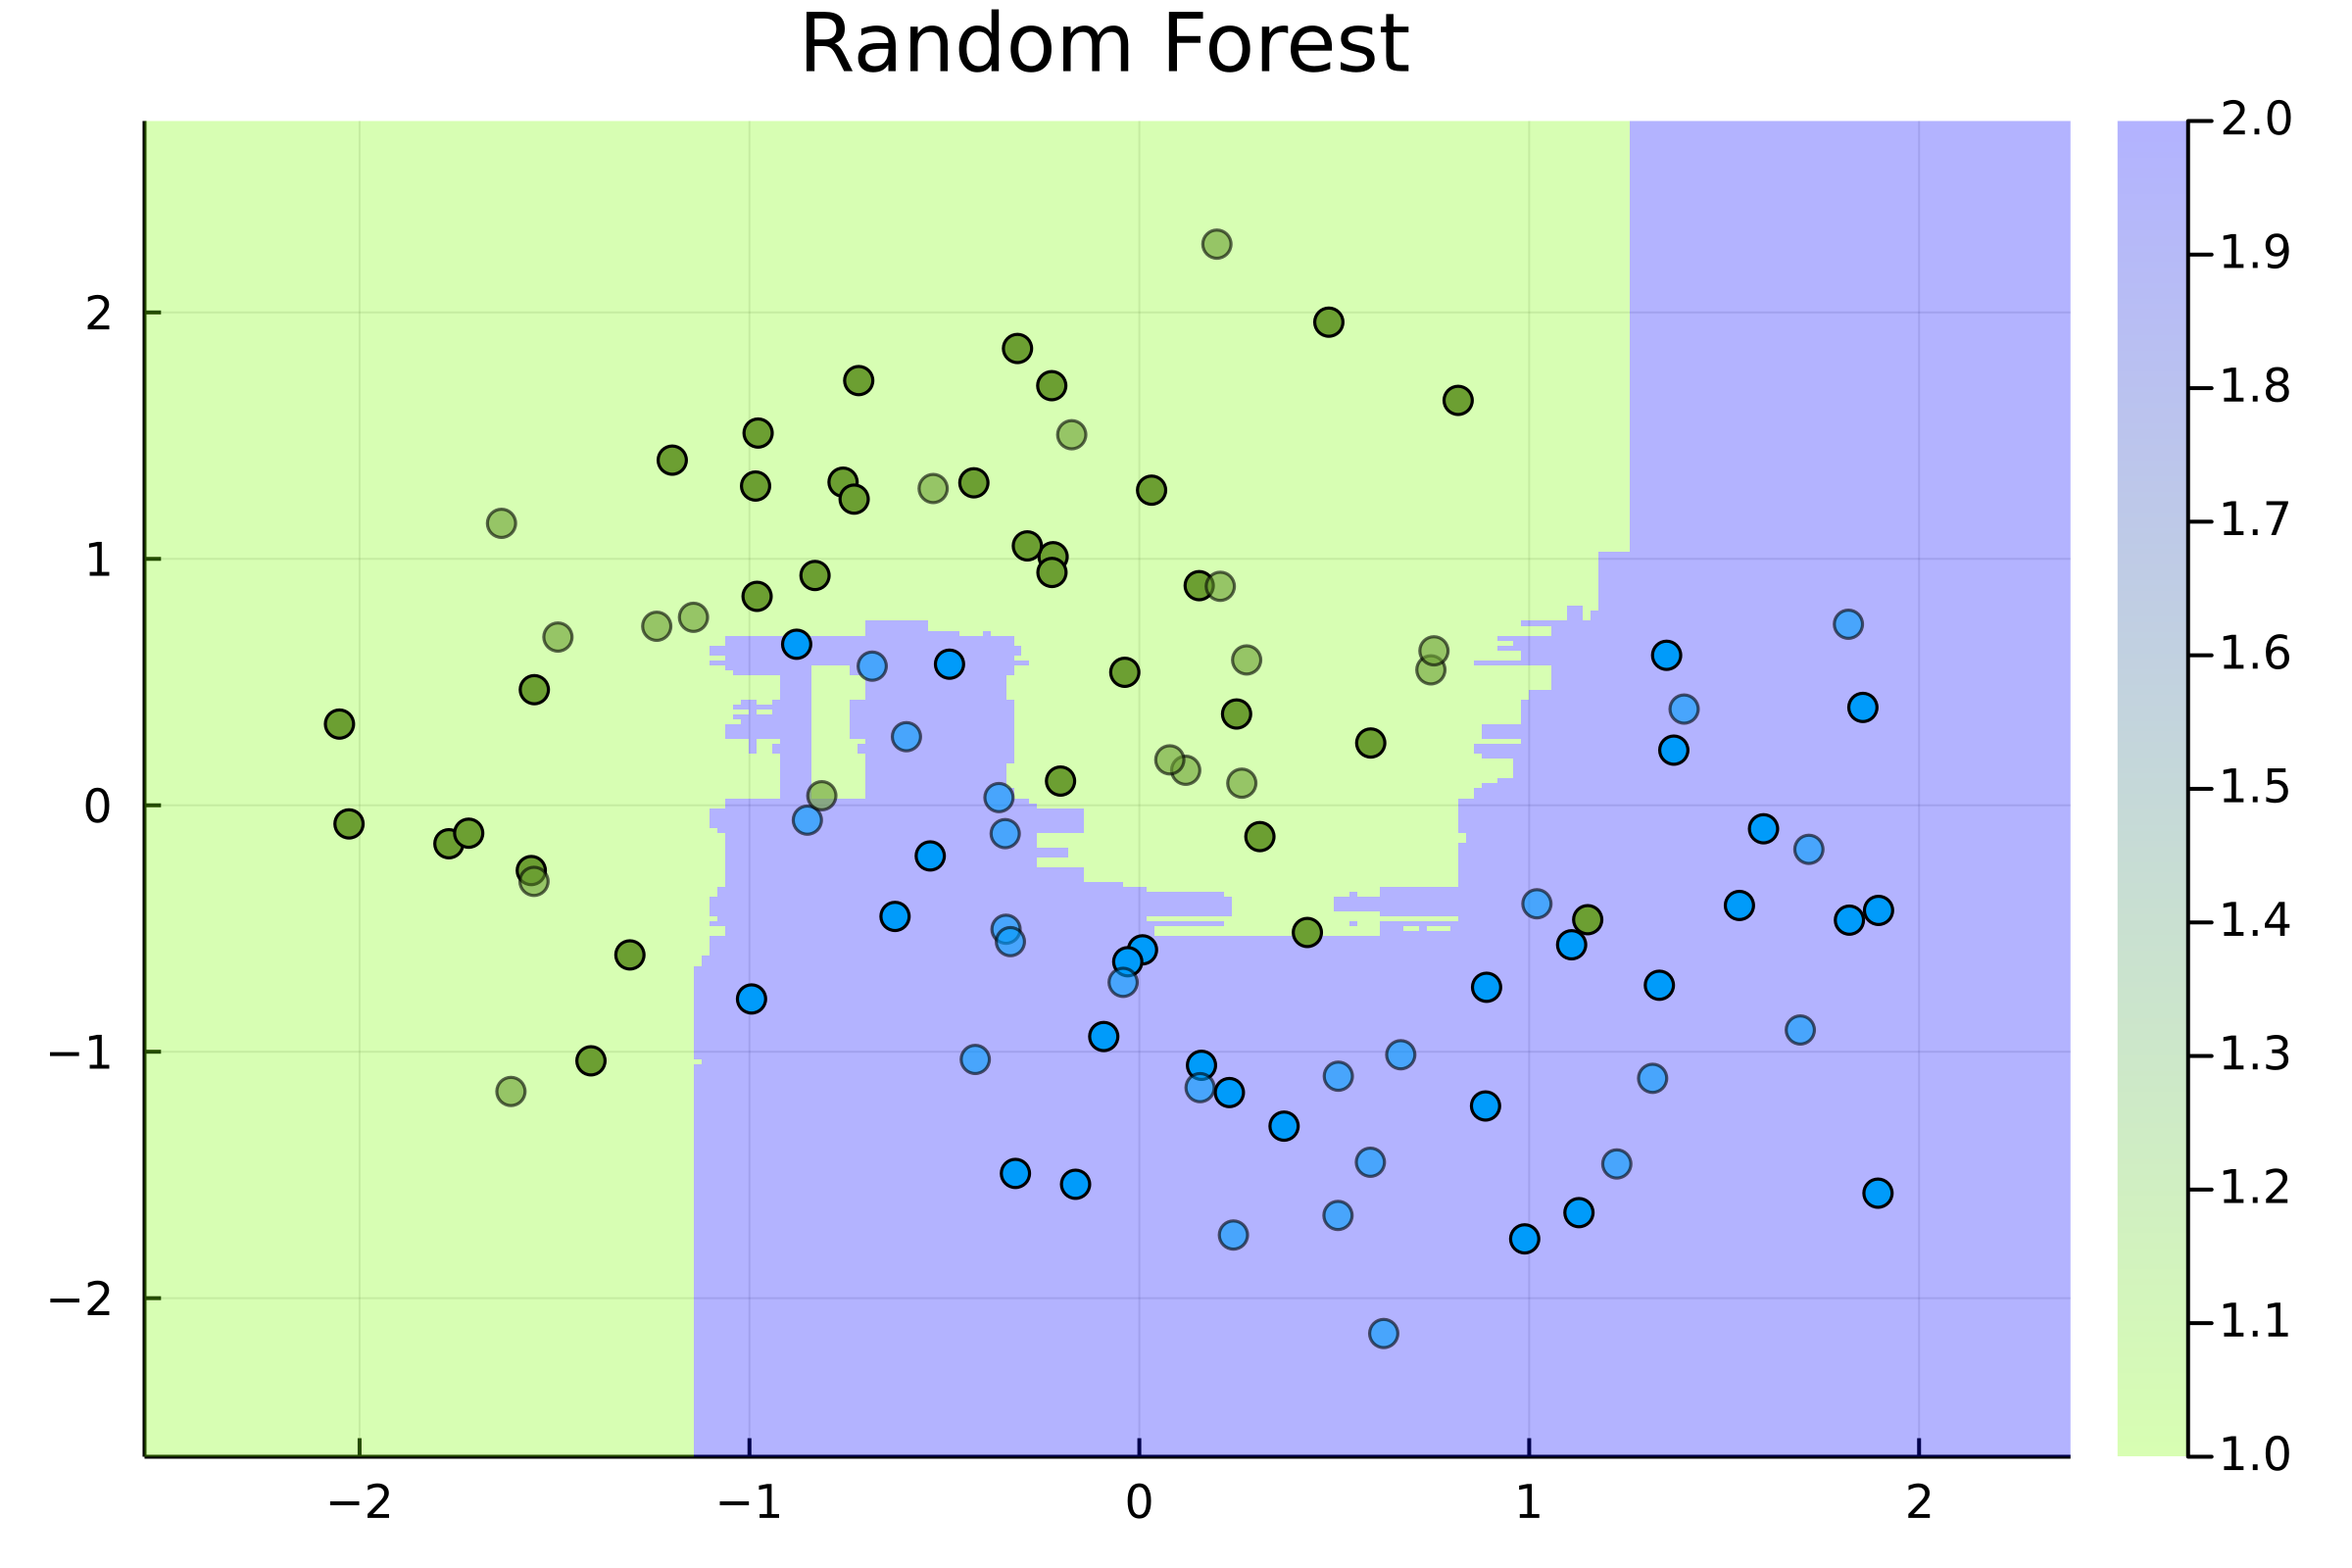
Classification
Can we find a well defined boundary in a (to be determined) feature space
Can we make sense of that boundary
Physically
With a data driven relation

